Slide 5
ANALYSIS OF TRUSS BY METHOD OF SECTIONS

Slide 6
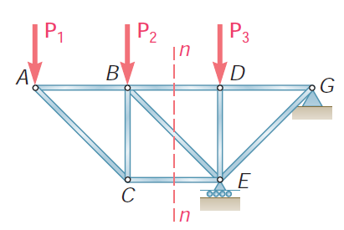

Slide 7
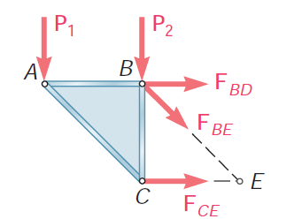

Slide 8
F_{BD} (take moment about point E)
F_{CE} (take moment about point B)
F_{BE} (ΣFy= 0)

Slide 9
V_{A} = 72.5 kN V_{D} = 77.5 kN
40 kN
50 kN
B
C
A
D
E
60 kN

Slide 10
V_{A} = 72.5 kN V_{D} = 77.5 kN
40 kN
x
50 kN
B
C
A
D
E
x
60 kN

Slide 11
40 kN
B
F_{BC}
F_{BE}
A
E
F_{AE}
V_{A} = 72.5 kN
F_{AE} (take moment about point B)
F_{BE} (ΣFy= 0)
F_{BC} (take moment about point E)

Slide 12
40 kN
B
F_{BC}
F_{BE}
A
E
F_{AE}
V_{A} = 72.5 kN
(ΣFy= 0)
72.5 – 40 – F_{BE}cos30 ° = 0
F_{BE} = 37.57 kN (tension)
F_{AE} (take moment about point B)
(ΣM_{B}= 0)
(72.5 x 1.5) – (F_{AE} x2.59) = 0
F_{AE} = 41.98 kN(tension)

Slide 13
40 kN
B
F_{BC}
F_{BE}
A
E
F_{AE}
V_{A} = 72.5 kN
F_{BC} (take moment about point E)
(ΣM_{E}= 0)
(72.5 x 3) – (40 x 1.5) + (F_{BC} x2.59) = 0
F_{BC} = – 60.81 kN(Change the direction of arrow)
F_{BC} = 60.81 kN (compressive)

Slide 14
The following table list the forces, the magnitude and nature of the forces.
Sr. No. | Member | Force (kN) | Nature
1 | AB | 83.71 | COMPRESSIVE
2 | BC | 60.61 | COMPRESSIVE
3 | CD | 89.48 | COMPRESSIVE
4 | ED | 44.74 | TENSILE
5 | DC | 31.75 | TENSILE
6 | BE | 37.52 | TENSILE
7 | AE | 41.85 | TENSILE

Slide 15
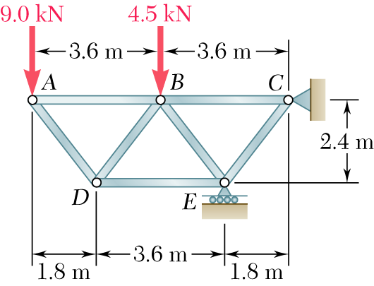
Determine the force in the member BD and DE.

Slide 16
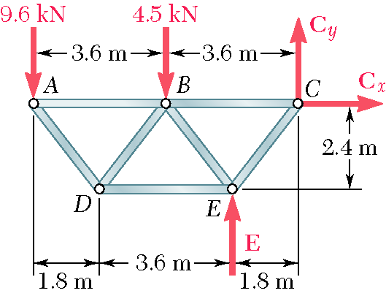
Based on a free-body diagram of the entire truss, solve the 3 equilibrium equations for the reactions at E and C.

Slide 17
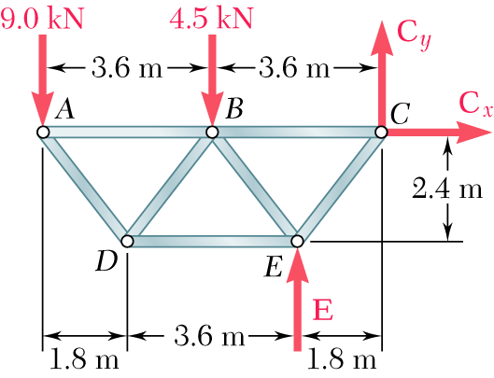
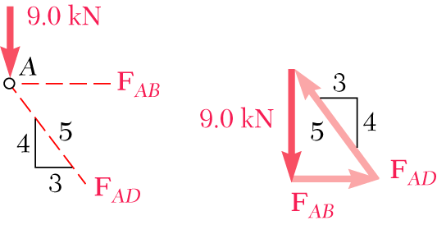
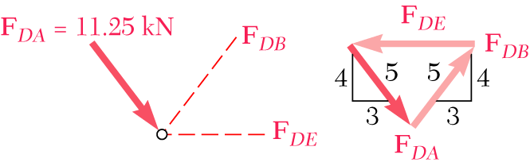
Joint A is subjected to only two unknown member forces. Determine these from the joint equilibrium requirements.
There are now only two unknown member forces at joint D.

Slide 18
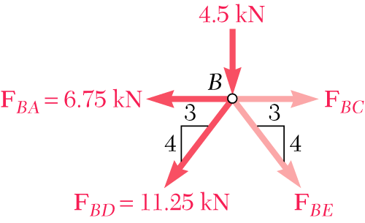
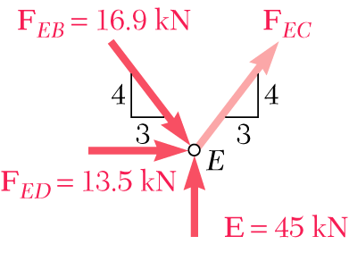
There are now only two unknown member forces at joint B. Assume both are in tension.
There is one unknown member force at joint E. Assume the member is in tension.

Slide 19
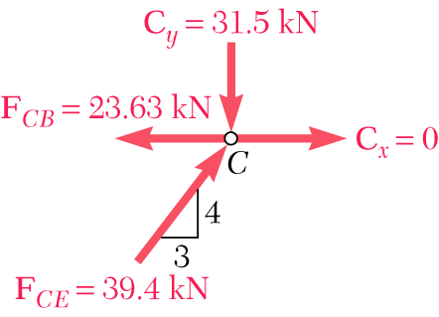
All member forces and support reactions are known at joint C. However, the joint equilibrium requirements may be applied to check the results.

Slide 20
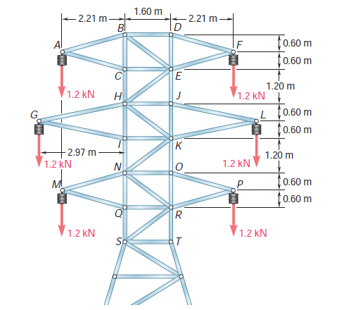

Slide 21
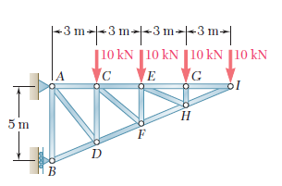
Determine the force in members CD and DF of the truss
shown.

Slide 22
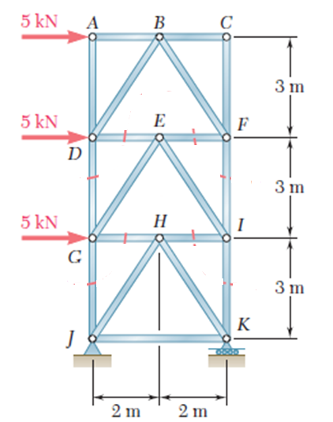
Determine the force in members DG and FI of the truss shown

Slide 23
Determine the force in members GJ and IK of the truss shown

Slide 24
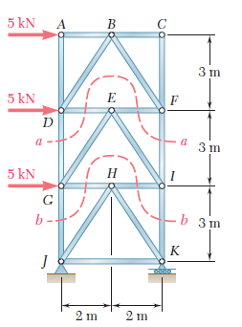

Slide 25
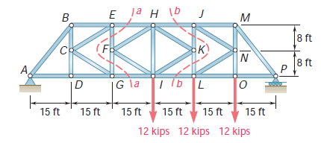
Determine the force in members EH and GI of the truss shown

